Slide 1
Gameification of Data Presentation
By: Team 1
Ryan Ross
Cam Kozan
Zaid Alsafi
Alex Navarre

Slide 2
Project Overview Introduction
To create a webpage for companies to present easily digestible data for their employees to view and track metrics. The purpose of this is to create a friendly and competitive environment where workers will be motivated to change and develop better behaviors and practices determined by the company.

Slide 3
Major Software Functions
Inputs
Login Info
Employee Data
Weight values
Processes
Retrieve data from database
Verify login
Choose user view
Apply score weight
Outputs
Display user view
Display employee leaderboard
Display employee specific information

Slide 4
Budget and Resource Estimation
Function Points
Process/Task
Lines Of Code
 | Complexity
Component | Low | Average | High
EI | 3 | 4 | 6
EO | 4 | 5 | 7
WQ | 3 | 5 | 6
EIF | 5 | 7 | 10
ILF | 7 | 10 | 15
Account Creation = 90 Hours
Dashboard = 200 Hours
Employee/Team Page = 120 Hours
Inventory = 100 Hours
Login Page = 70 Hours
Password Recovery Page = 70 Hours
Job Details = 80 Hours
Total = 730 Hours
Total = $54,750
Account Creation = 800 LoC
Dashboard = 2000 LoC
Employee/Team Page = 1200 LoC
Inventory = 600 LoC
Login Page = 300 LoC
Password Recovery Page = 900 LoC
Job Details = 1300 LoC
Total = 7100 LoC
EI=4*6 EO=5*5 EIF=7*0 ILF=10*3
79*9 = 711 Hours Total=$53,325

Slide 5
Budget and Resource Estimation
Function Points
Process/Task
Lines Of Code
780 Hours
Total = $58,500
790 Hours
Total = $59,250
8,000 LoC
Our final decision ended up being 760 hours total which would cost $57,000. We made this our final estimate because it was the closest to our Process/Task Estimates and out of all the estimates we believe that this will inform us that we have a lot of work to do.

Slide 6
Hardware/Software resources needs
GitHub
AWS
Discord
Visual Studio Code
Eclipse
Visual Studio
Draw.io
Azure Microsoft
SQL
C#
.Net
AngularJS

Slide 7
Risk analysis/Management
Name | Probability | Impact | Mitigation | Contingency Plan
Scheduling | high | high | Good communication and multiple meeting times possible to include everyone | If a person/people can't make it, keep them in the loop. Make certain everyone knows what they are responsible for.
Working on a project created by another team | high | medium | Figuring out how their code works along with integrating new code with theirs. | Members will have to learn a new language to understand what the current functionality does.
New functionality arises | high | high | Create an outline of what is in the scope of our work and what is not. | Refer to the created document to see if the functionality is within scope. If it is not in scope, they can remove functionality that is within scope as a trade off.
Bad communication | high | medium | Send a follow-up email 24 hours after the initial email was sent. | Take the assumption route until they respond.
Working with new technologies | high | medium | Use Mob programming to figure out and tackle the new technology. | Try to find someone whom may be able to help with the said technology. If we cannot find anyone, we may send an email to the clients.

Slide 8
Overview of Risk Mitigation, Monitoring, and Management
The team will review risks at meetings and over discord. We shall decide if any actions need to be implemented in order to minimize and or handle the risk. Risk and the mitigation plan will be updated as needed. If a risk needs urgent attention, the team will communicate through discord to determine the best plan of action at that time. If the mitigation plan cannot be agreed upon by all members, the team lead will make the executive decision.

Slide 9
Product and Process Models
We will be using an agile development approach to allow for greater ability to handle changes in the project. There will be five main phases to keep on track, Client selection and requirement gathering, Design, Prototype, Implementation, and Testing and Client acceptance.

Slide 10
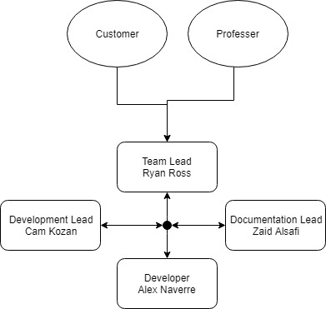
Team Organizational Structure

Slide 11
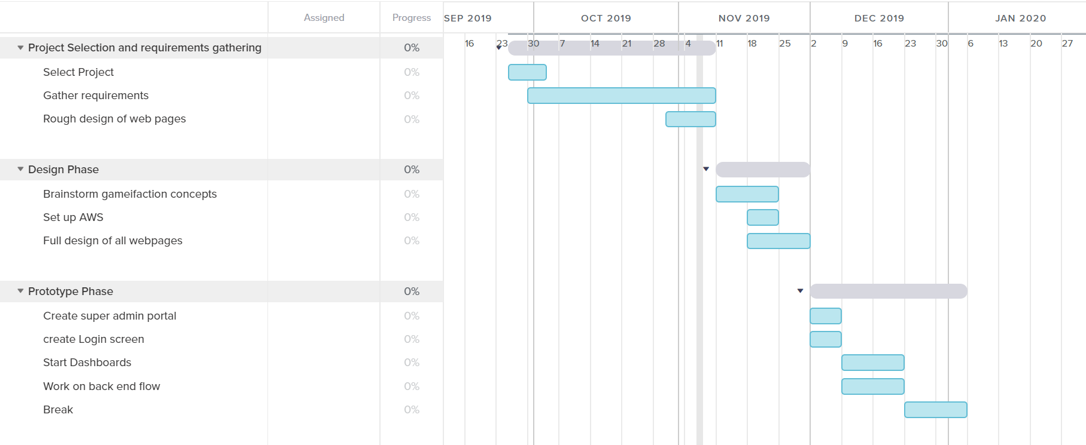
Project Schedule

Slide 12
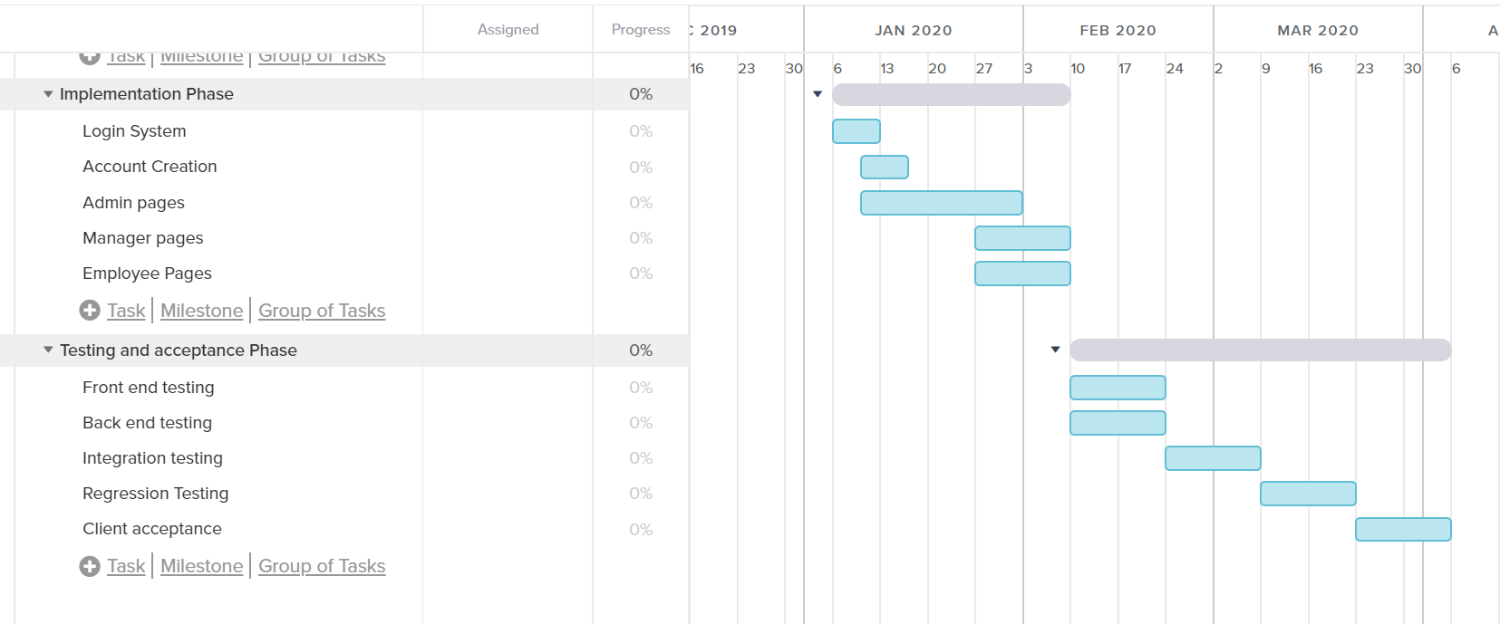
Project Schedule

Slide 13
Team Members Responsibilities
The team is structured to involve each member during initial drafting periods, and then responsibilities are assigned as a concrete plan gets set. Members are assigned very similar jobs during the early weeks of the process to collect opinions and ideas, with the intention of obtaining input from all team members.
The roles of each team member are as follows:
Ryan Ross- Team Lead
Cameron Kozan- Design Lead
Alex Navarre- Software Engineer
Zaid Alsafi- Documentation Lead

Slide 14
END

